Slide 1
Chapter 3
Internet of Things Security Requirements, Threats, Attacks, and Countermeasures

Slide 2

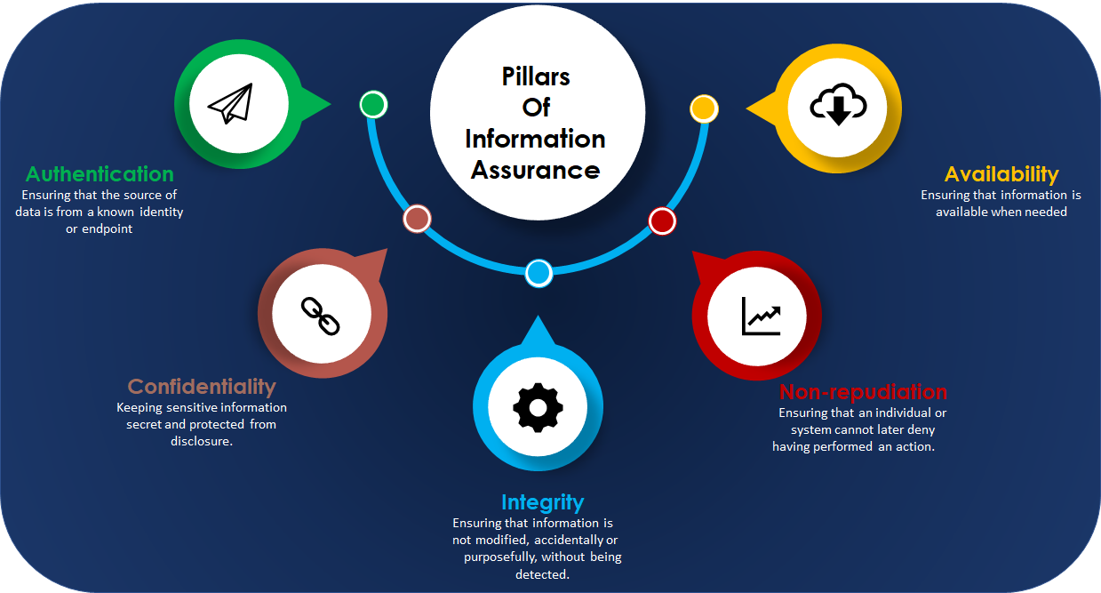
Security Requirements in Internet of Things

Slide 3
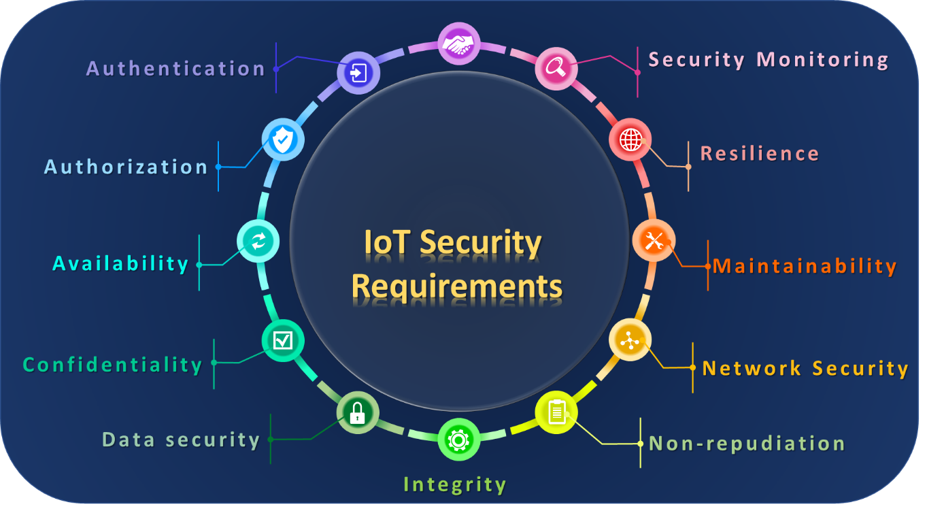
Security Requirements in Internet of Things

Slide 4
IoT threats, Attacks, vulnerabilities, and risks
IoT Threats
IoT Vulnerabilities
IoT Risks

Slide 5
IoT Threats
Features | Active Threats | Passive Threats
Modification | Modification in information takes place. | While in passive attack, Modification in the information does not take place.
Security target | Endanger the availability and Integrity. | Endanger for Confidentiality.
Community Focus | attention is on detection. | attention is on prevention.
The impact | system is always damaged. | There is not any harm to the system.
Victim awareness | A victim gets notified about the threats. | A victim does not get notified about the threats.
Resources | IoT resources can be changed. | IoT resources are not changing.
Services | They interrupt the services of the system. | Just acquire the information and messages in the system
Categories | Interruption threats Modification threats Fabrication threats | Traffic analysis Release of message contents Passive reconnaissance

Slide 6
Today's IoT attacks and Countermeasures
Physical IoT attacks
Software-related IoT attacks
Data-related IoT attacks
Protocol-related IoT attacks

Slide 7
IoT Attack Surfaces
Physical surface
Network surface
Cloud surface
Application surface.

